Slide 1

Cyber Security
Greg McClelland
Greg.mcclelland@swcsd.us
SWCA_Cyber@twitter
What is it? What do people in Cyber Security do? What’s the big deal?

Slide 2

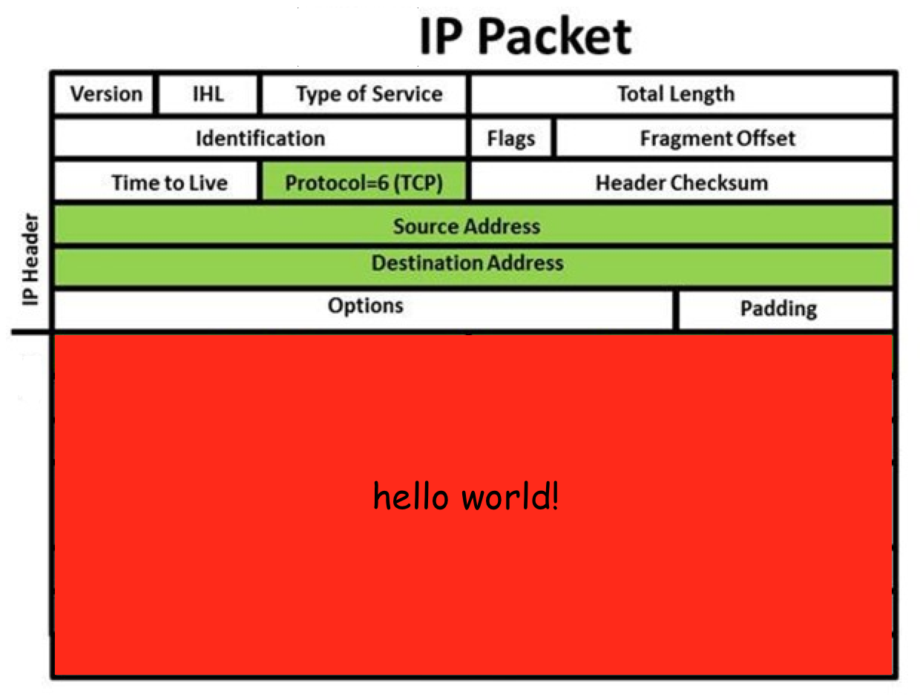
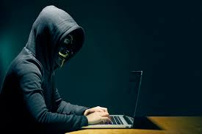


Slide 3

Needed Reality to Parents, Admin, Students and Tech Coordinators…...
We are NOT….
Hackers

Slide 4
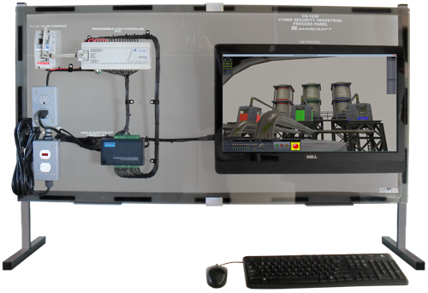
Background and Lessons
Learned
28% job growth 2016-2026
Staff opening -teacher hired from industry
ODE Pathway N2 Networking: Networking, Network Operating Systems,Network Management and Network Security
Franklin University partnership 32 college credits
Columbus State Community College program
Lab resources: Marcraft
Comptia Testing Materials

Slide 5

My Road Map to Teaching Cyber Security
History Teacher with Masters in Tech Facilitation
15 years in the class, 2 as a Computer Science Teacher
Vex Robotics Coach and Building BTC
Websites, ordering, some scripting, computer repair
PLTW Computer Science and Engineering
Python
Web Scripting (java and html)
SQL

Slide 6
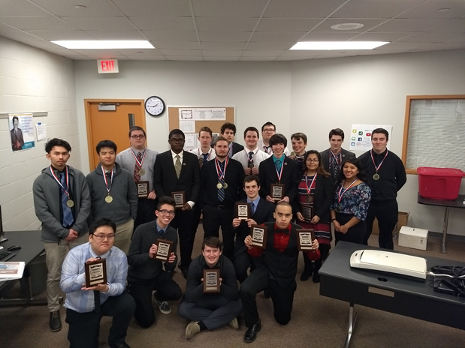
My Focus
Cyber @SWCS
Finding a way to get kids involved in the programming process while learning the skills necessary in Cyber Security
Room Design
Instructional Formatting
  Labs- 2.5 Hours
  Traditional Teaching
  Collaboration
  Presentations
Materials
  Preparation for Comptia’s
    Security+
    Network+
    IT fundamentals

Slide 7
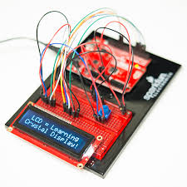
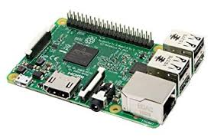

Growing the Program
The Hook
Columbus State
Stackable Certificates
High Paying Jobs
Major companies looking for help
New Tech Toys
Year 1 - 20 Students
Year 2 - 18 Students
Year 3 -24 Students with a waiting list (my first year recruiting)

Slide 8
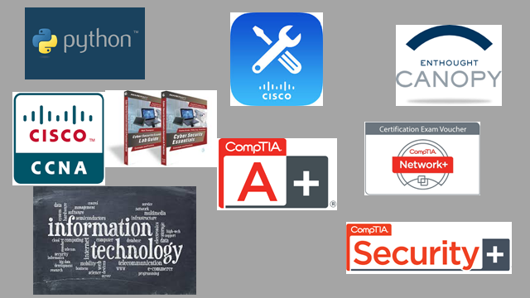
Certifications

Slide 9
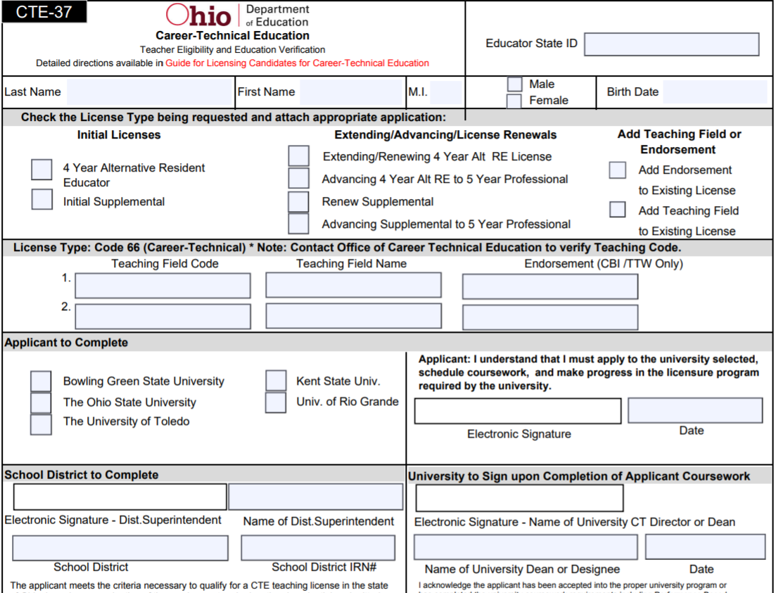
Expectations
What can you expect out of a Cyber Teacher?
  Is it a returning Networking Teacher?
  Did you hire from outside?
Finding Resources
  Where do you look? Who has the answers?
WebXams
  The crosswalk between Cyber and Networking is difficult to maneuver.
  ODE courses are developed
CTF’s and Hackathons
  What are they? How do you get involved?

Slide 10
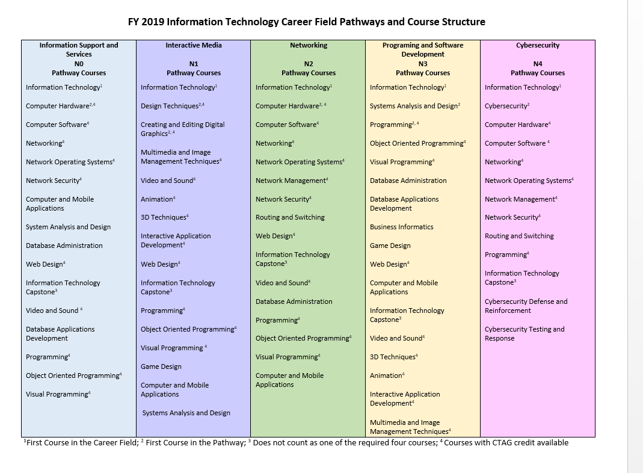

Slide 11
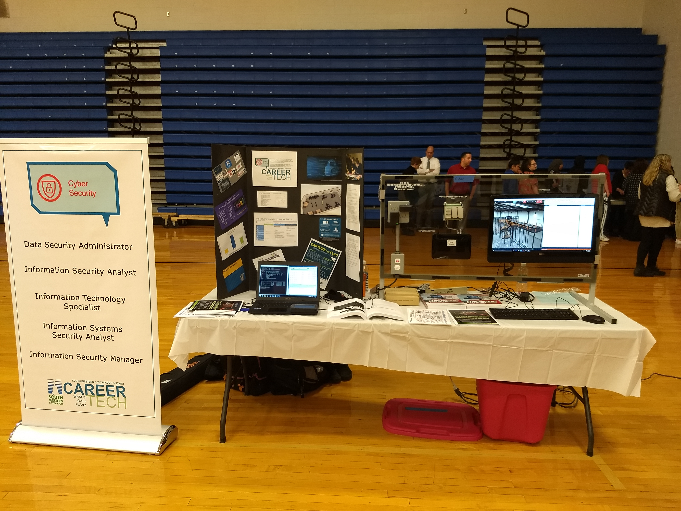
Recruitment

Slide 12
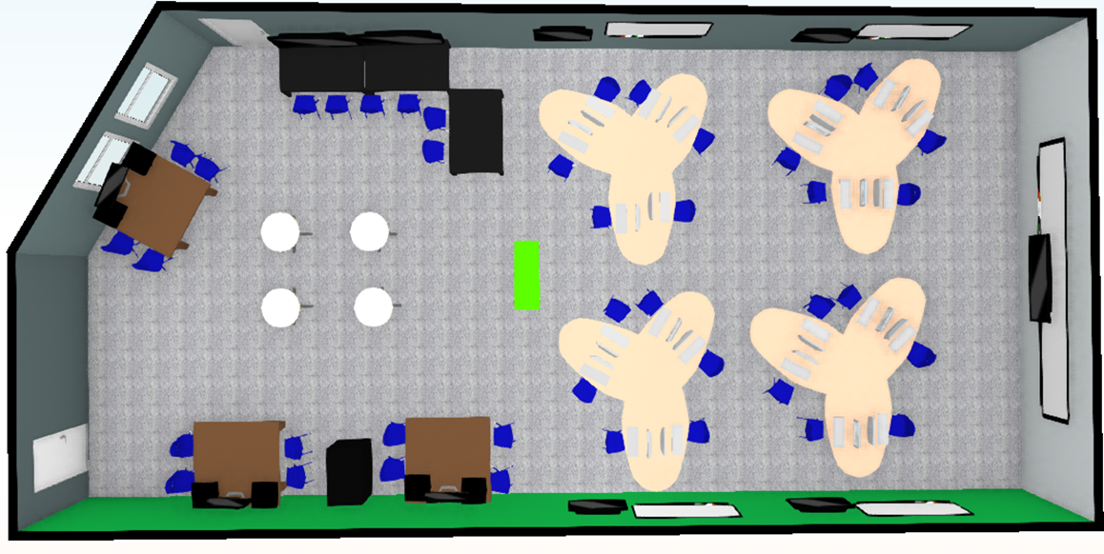
Traditional lab space does not encourage the skills we are looking for

Slide 13
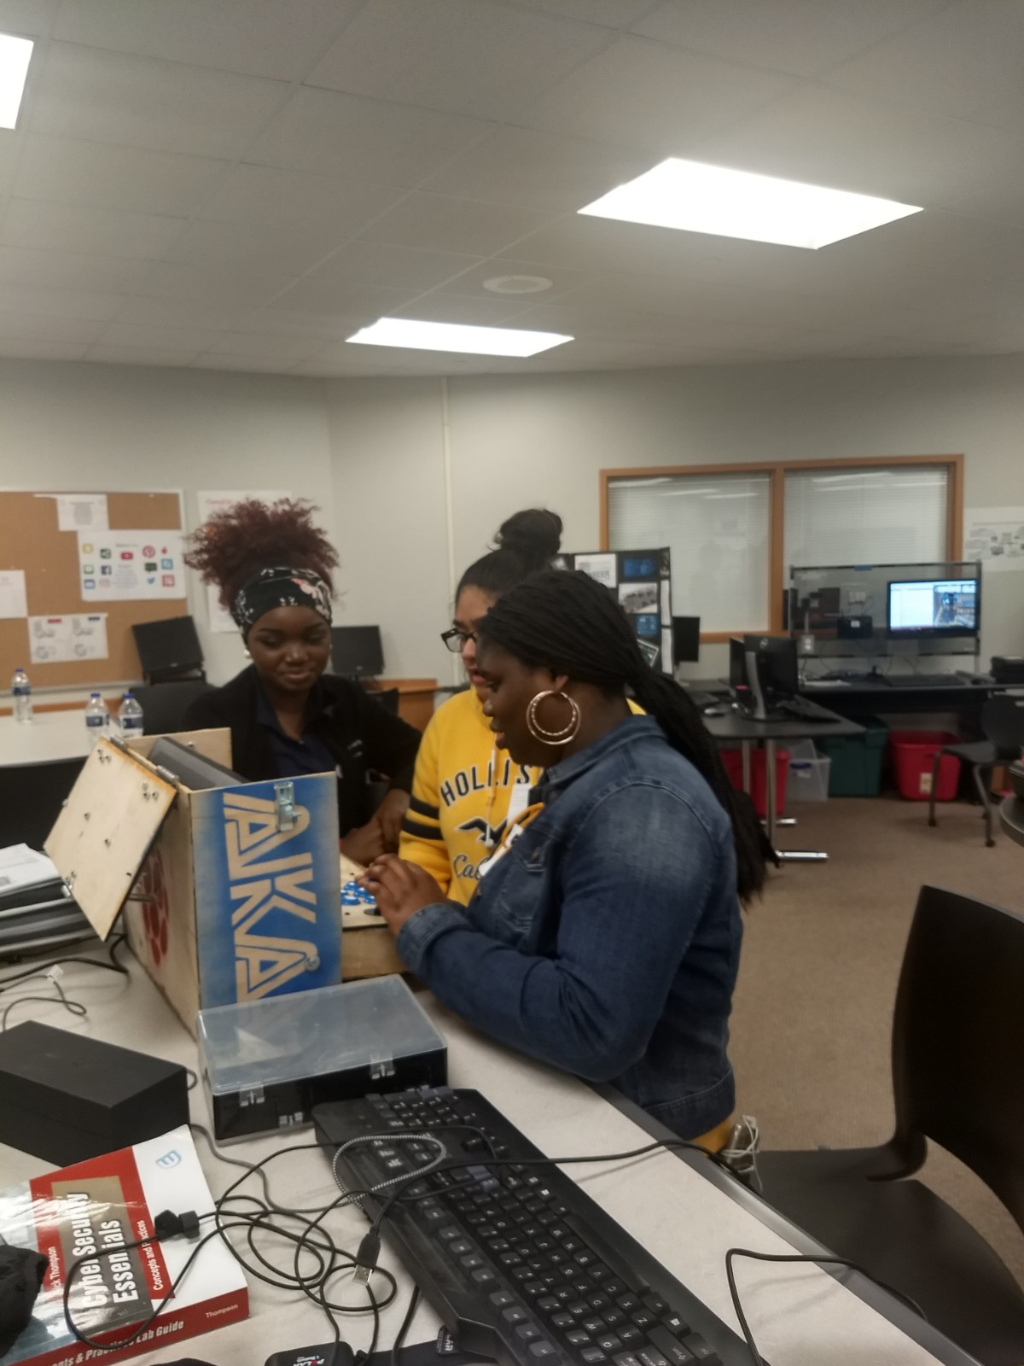
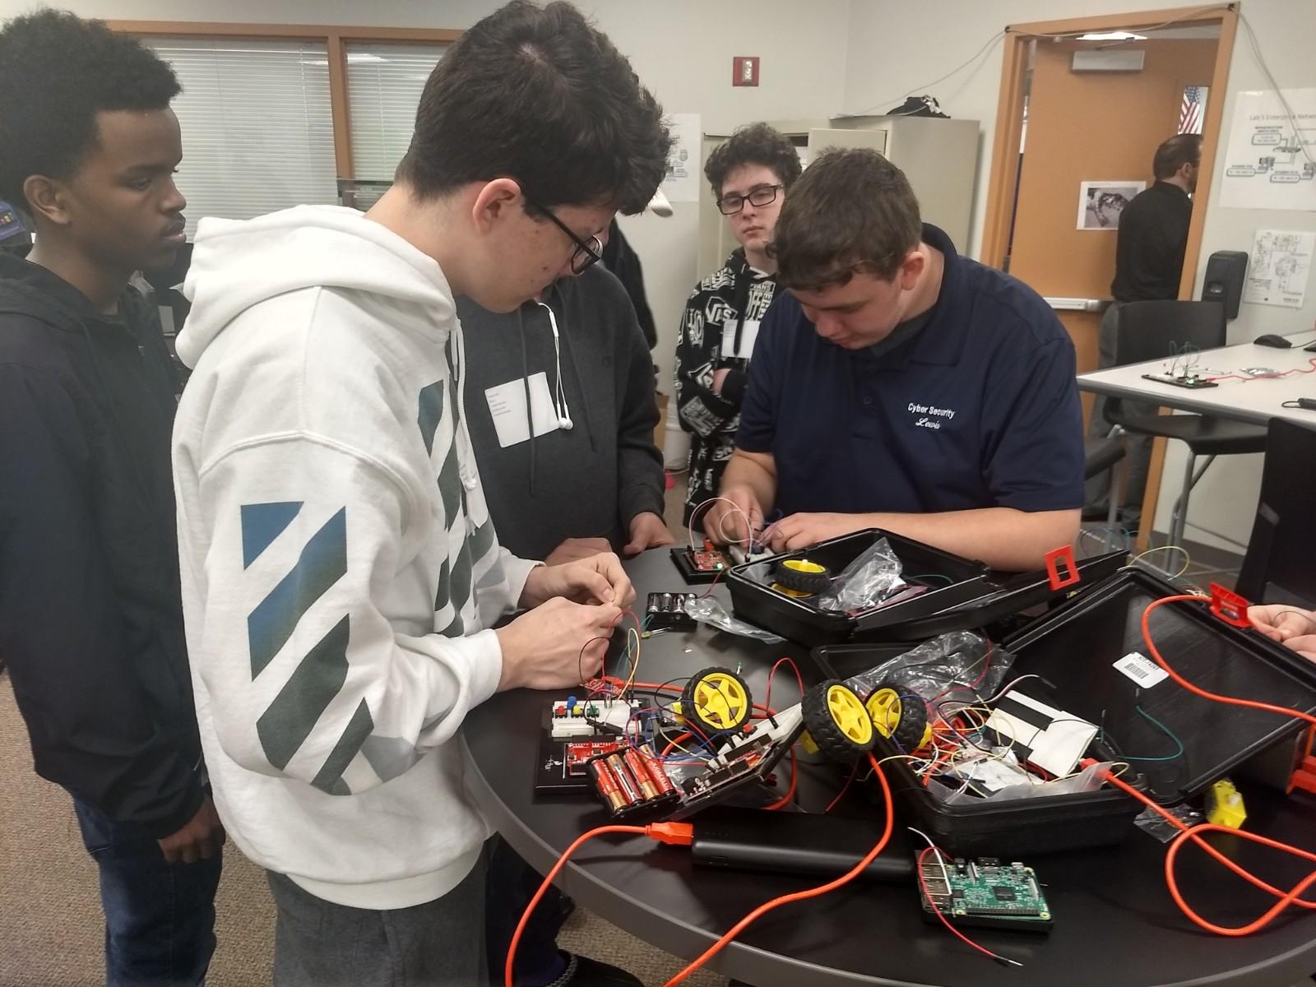
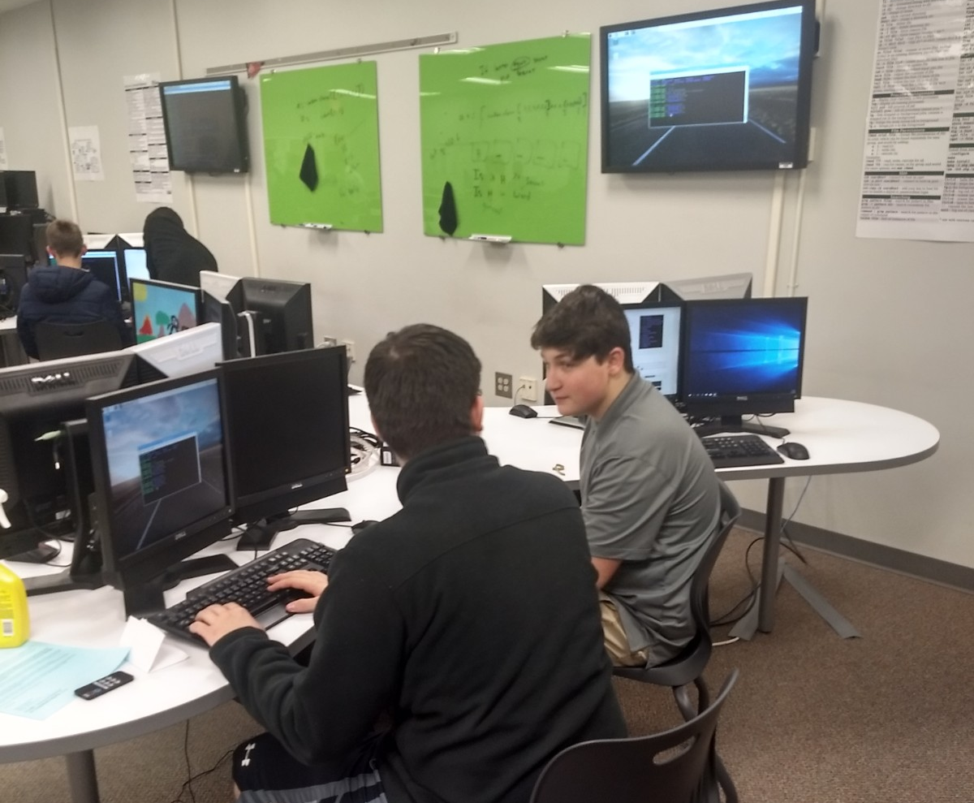

Slide 14

Internships and Opportunities
The process of Creating Internships can be messy
Four students start 6 week internships
Trying to create the balance of students necessary
Computer Kids tend not to care about driving
Be hones and open!!!
Who wants to let a 18 year old student behind the scenes of
A billion dollar industry?
Why would they want to let a student in?? (They have good
Reasons to)

Slide 15
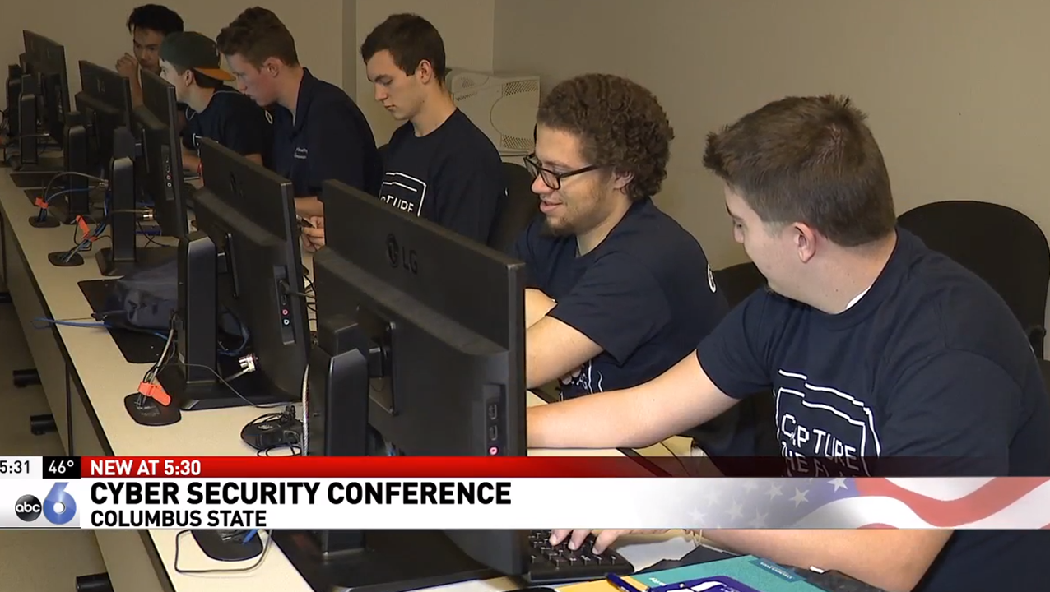
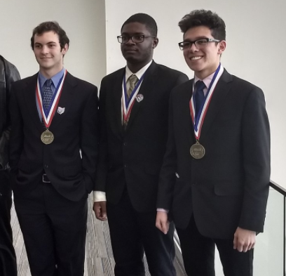
Group Activities
Capture the Flag
BPA
Classroom Security Scenario
Westerville CTF
Columbus Dispatch

Slide 16
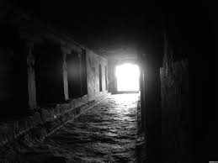
We are we headed?
21st Century Learning Suite
Ohio Cyber Collaboration Committee
Mark Bell
OARnet
Franklin University
Columbus State
Amy Schakat
amy.schakat@swcsd.us
Greg McClelland
greg.mcclelland@swcsd.us

